Slide 1

Clarity
Intelligent Code Correction & Refactoring
Team Members: Nipun, Sahil, Mo Zaid, Shivansh

Slide 2
What is Clarity?
Clarity is a code correction web app
User enters code in browser
AI corrects the code
Result is shown on screen

Slide 3
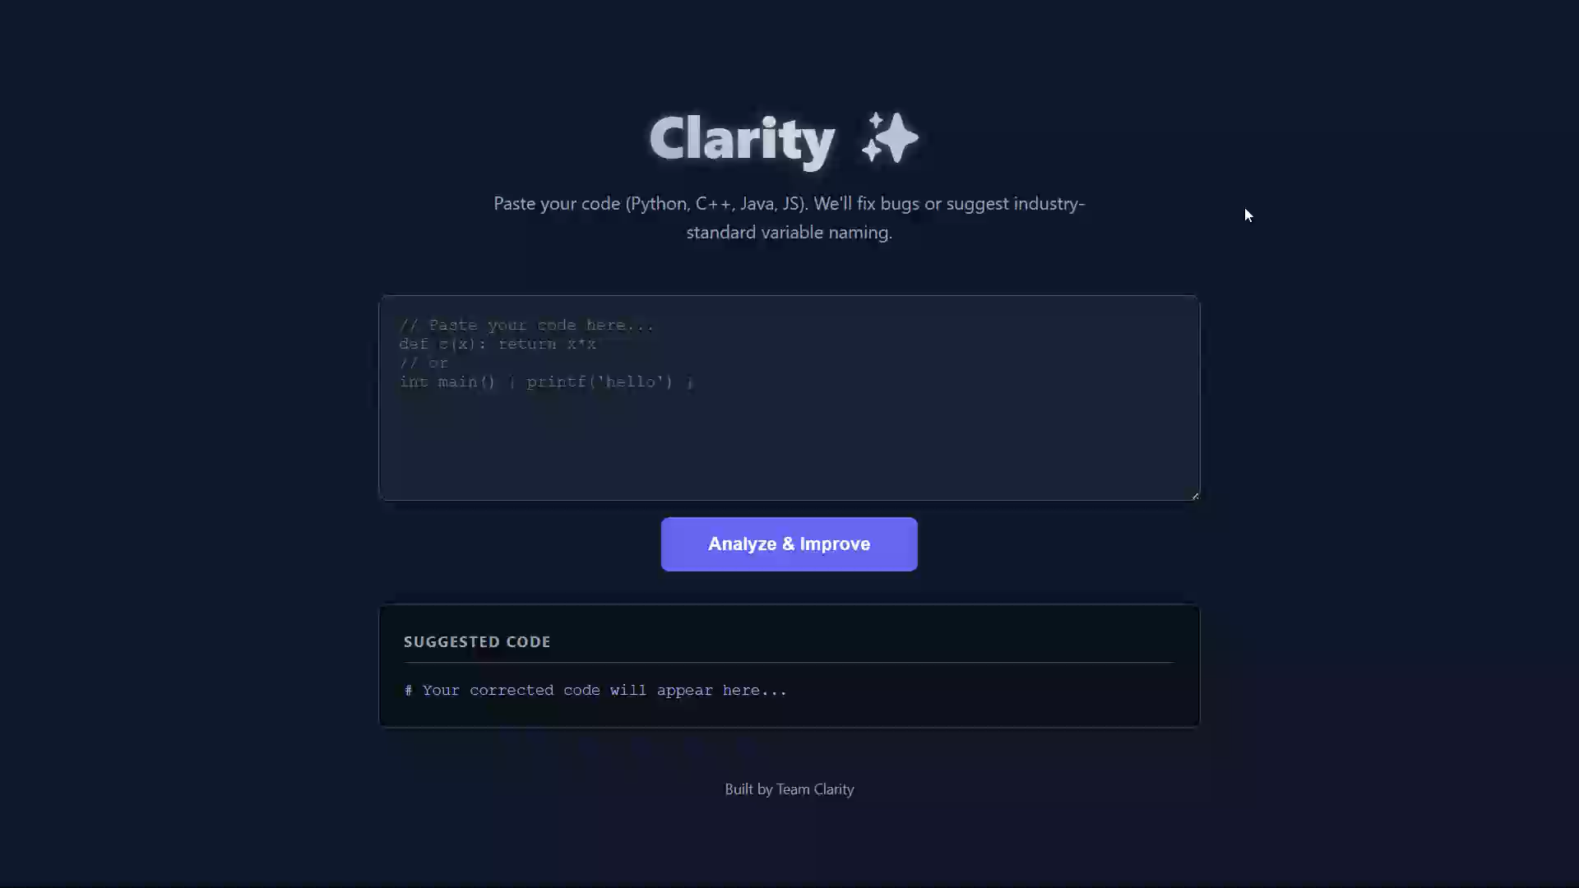
Demo:

Slide 4
Phase 1 Backend (Mock)

Slide 5

The Backend
A scalable server structure ready to host the AI model.
Handles API requests
Executes AI model inference
Returns corrected & optimized Python code
The backend drives the AI code correction engine.

Slide 6
Backend Technology Stack
• FastAPI – High‑performance API layer
• Python – Core logic & model driver
• HuggingFace – Model inference
• Uvicorn – ASGI server for deployment

Slide 7
How the Backend Works
1. User submits Python code
2. FastAPI endpoint receives request
3. Backend sends code to AI model
4. Model predicts corrected code
5. JSON response is returned to frontend

Slide 8
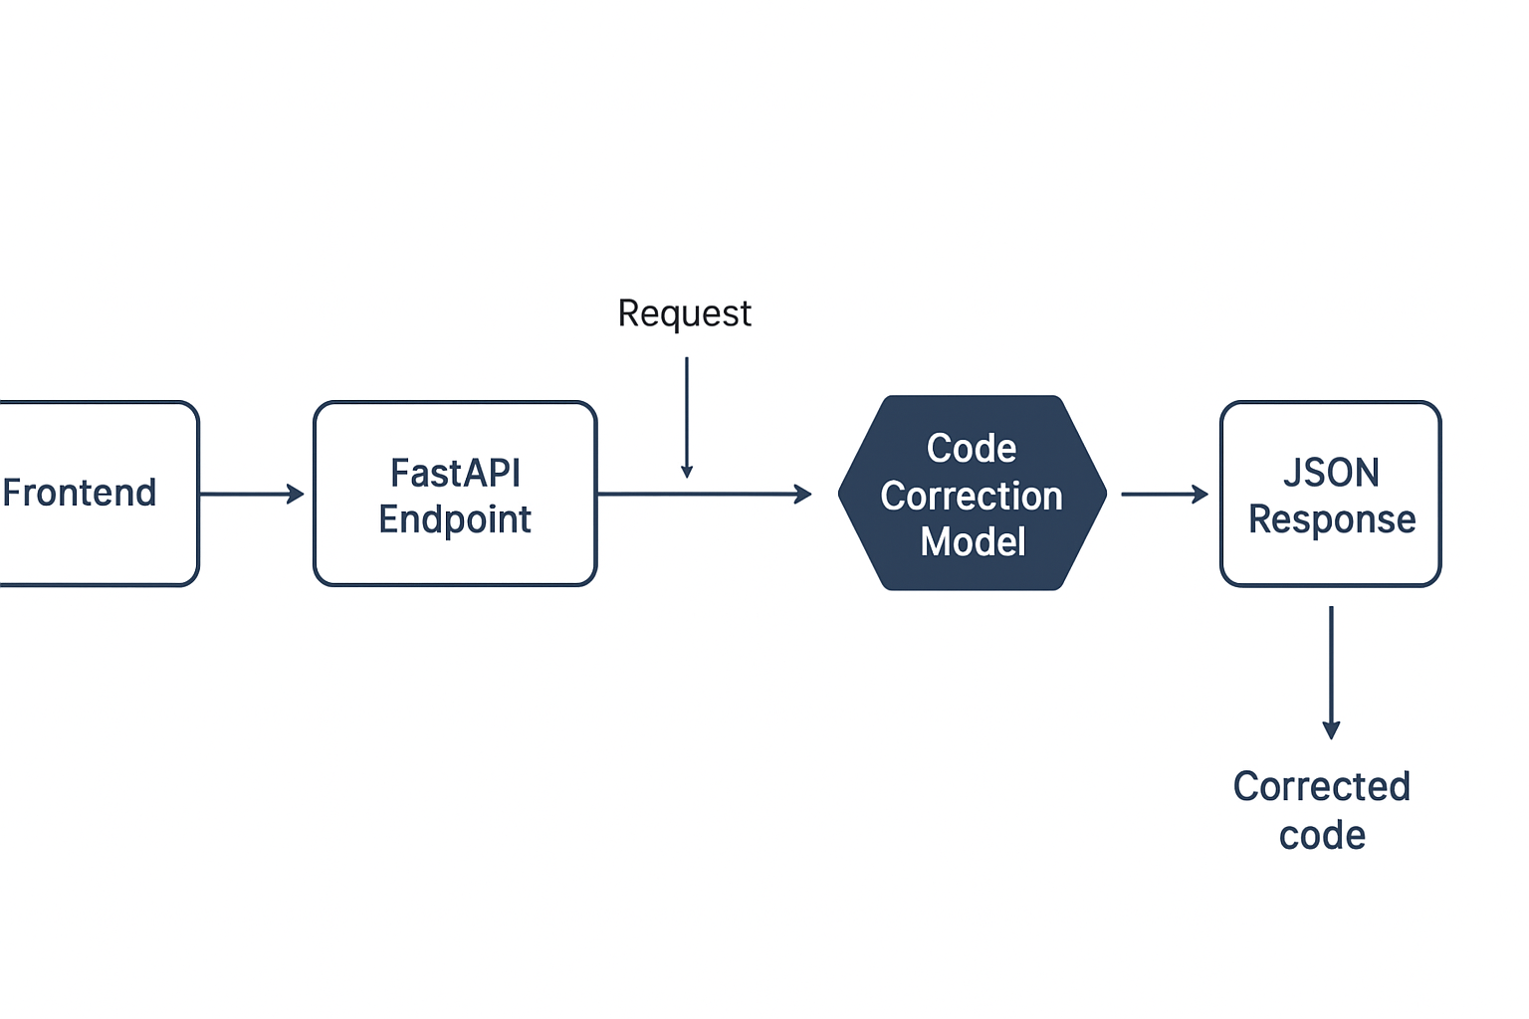
Backend Architecture Diagram

Slide 9
Phase 2 Frontend

Slide 10



Frontend

Slide 11

With HTML

Slide 12
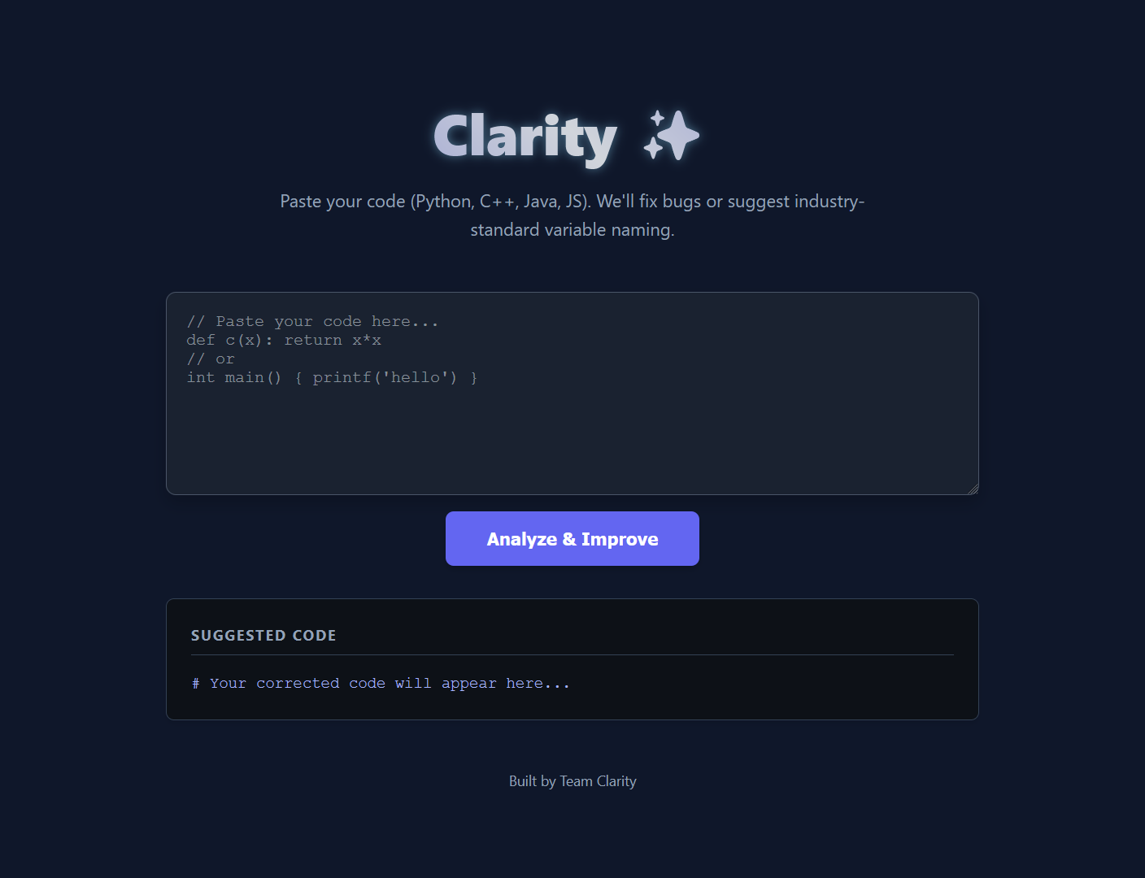
With CSS
Focus is on making UI usable and clean.

Slide 13
Phase 3 & 4 Model Selection & Integration

Slide 14
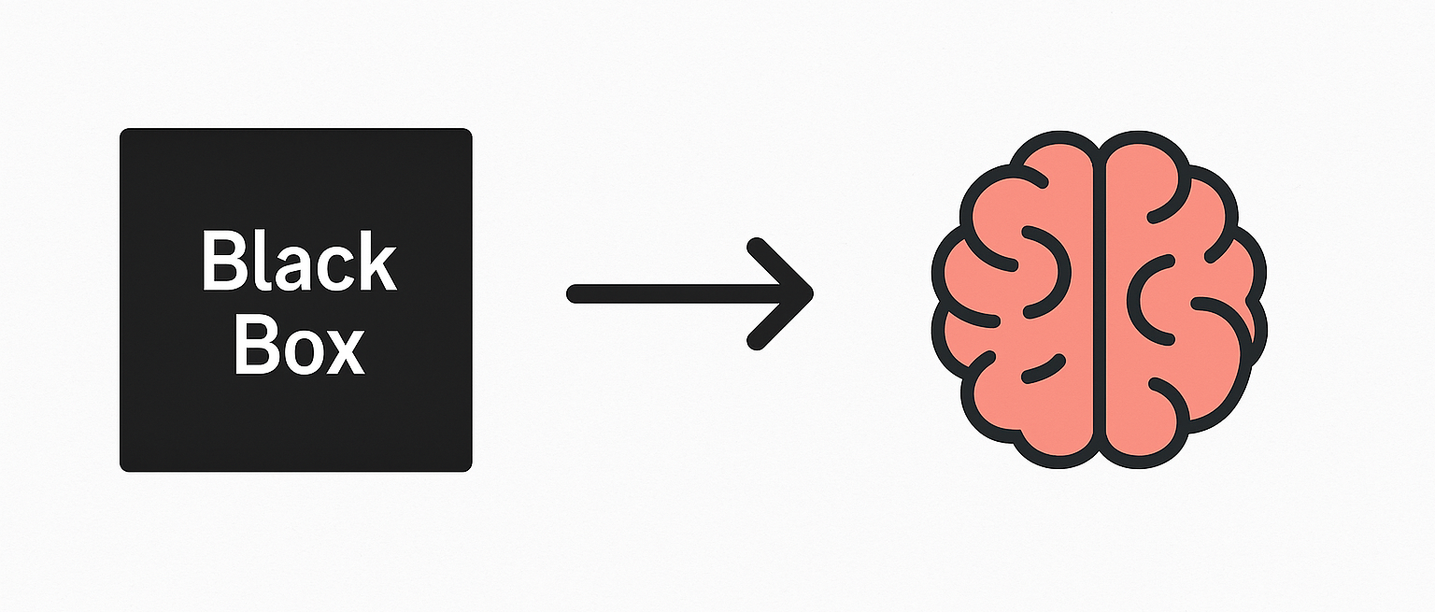
The AI Brain & Integration
Objective: Intelligence Injection & System Unification.

Slide 15
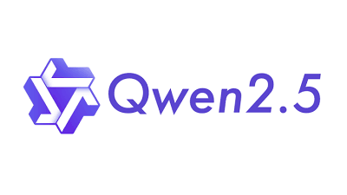



The Brain (Phase 3)
Model: Qwen/Qwen2.5-0.5B-Instruct (via Hugging Face).
Why this model? Optimized for instruction following; low latency for real-time use.
Pipeline: Text-Generation inference pipeline.

Slide 16
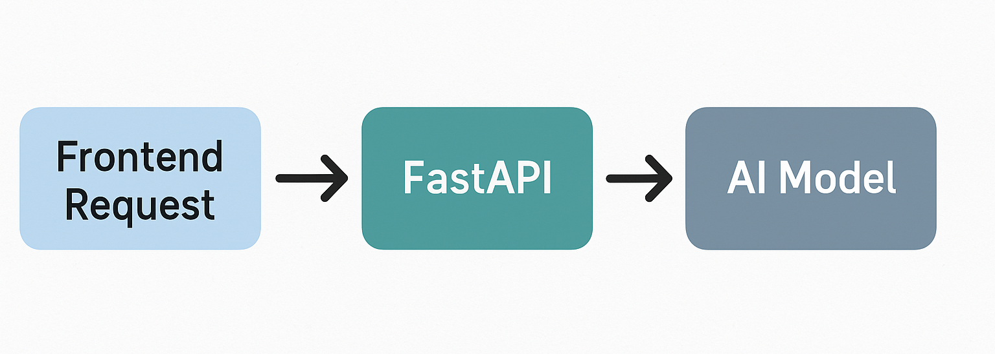
The Integration (Phase 4)
Replaced mock responses with real-time inference.
Implemented error handling for model timeouts or failures.
Outcome: A fully functional "Smart" backend connected to the UI.

Slide 17
Phase 5 Deployment

Slide 18
How the App Works
Frontend runs on Vercel
Backend runs on Hugging Face
Frontend sends “BUGGY” code to backend through api
Backend returns corrected code to frontend

Slide 19
Backend (Hugging Face)
Backened consist FastAPI
AI model: Qwen-0.5B
Hugging face privides Free CPU used for hosting

Slide 20
Frontend (Vercel)
Consist of HTML, CSS, JavaScript
Hosted on Vercel
Connected to backend through API
website ready for users

Slide 21
Important Links
Frontend Website: logiclensclarity.vercel.app
Backend API: scriptsledge-clarity-backend.hf.space
API Path: /api/correct

Slide 22
What’s Now?

Slide 23
Future Plans:
Mobile App Development: Offline-first learning for remote areas (like our campus).
UI/UX Modernization: Professional, intuitive design overhaul.
Model Optimization: Faster inference, lower latency.
Advanced AI Integration: Implementing state-of-the-art models.
Multi-Model Support: Flexibility to choose the best AI for the task.

Slide 24
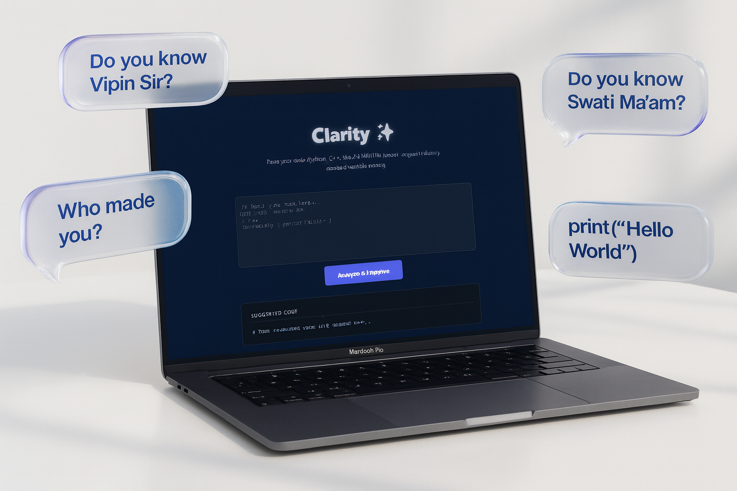
Thank You!
Questions?
Team Clarity:
Nipun Lakhera
Sahil Raikwar
Mo Zaid Sheikh
Shivansh Nigam
Under the Guidance of:
Guide: Prof. Vipin Verma
Co-Guide: Prof. Swati Patel
School of Information Technology
Try Clarity:
logiclensclarity.vercel.app
Source code:
github.com/scriptsledge/clarity

